Slide 1
Lab 2
Classes, Access Specifiers
and Static Members
Object Oriented Programming Sessional
Department of Computer Science & Engineering
Bangladesh Army University of Science & Technology, Khulna

Slide 2
LAST LAB
Where we left off
You wrote the same bank account twice: once with struct, once with class.
You saw a.balance = 1000000; compile in one version and refuse to compile in the other.
Today you build a class properly, from an empty file.
OOP Sessional · Lab 2 · BAUST Khulna
2

Slide 3
TODAY · 3 HOURS
The plan
A
40 min
Write a Student class from scratch
private data, public functions, inside and outside definitions
B
5 min
Break it on purpose
try to touch private data, record every error
C
40 min
Static members
a shared counter, and automatic IDs
D
35 + 25 min
Exercise
BankAccount with static members
OOP Sessional · Lab 2 · BAUST Khulna
3

Slide 4
PART A
Write the class
No copy and paste. Type it. That is part of the exercise.

Slide 5
PART A
What to build
class Student
{
private:
int roll;
string name;
double marks;
public:
void setData(int r, string n, double m);
char getGrade();
void display();
};
setData() must reject marks outside 0 to 100.
Define setData() INSIDE the class.
Define getGrade() and display() OUTSIDE, using Student::
Create three objects and display all three.
OOP Sessional · Lab 2 · BAUST Khulna
5

Slide 6
PART A
Two ways to define a function
// INSIDE the class
void setData(int r, string n, double m)
{
roll = r;
}
// OUTSIDE the class
void Student::display()
{
cout << roll;
}
The :: tells the compiler which class the function belongs to.
Without it, display() would be an ordinary global function with no access to roll.
OOP Sessional · Lab 2 · BAUST Khulna
6

Slide 7
PART B
Break it on purpose
Every error message you produce here is a mark in your report.

Slide 8
PART B
Four experiments
1
s1.marks = 150;
Touch a private member from main()
2
Remove the ; after };
Delete the semicolon at the end of the class
3
Delete Student:: from display()
Define the function without the scope resolution operator
4
Move setData() to private
Then try to call it from main()
For each one: write the EXACT message, then fix it and move on.
OOP Sessional · Lab 2 · BAUST Khulna
8

Slide 9
PART C
Static members
One variable, shared by every object of the class.

Slide 10
PART C
A book that numbers itself
class Book
{
static int totalBooks; // ONE copy for all
int id; // one per object
public:
void setData()
{
totalBooks++;
id = totalBooks; // takes the next number
}
static void showTotal();
};
int Book::totalBooks = 0; // COMPULSORY
OOP Sessional · Lab 2 · BAUST Khulna
10

Slide 11
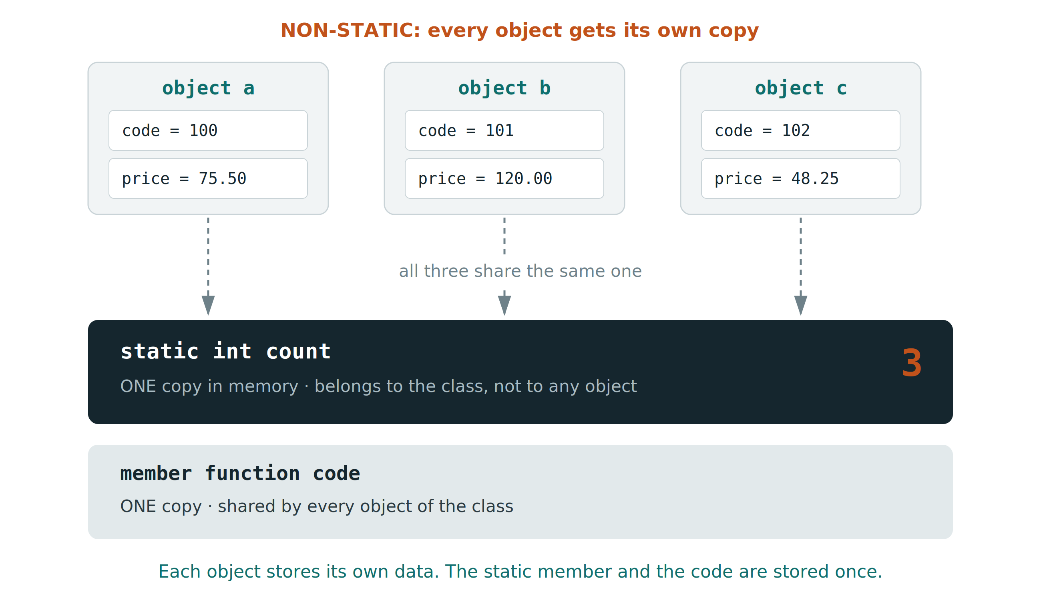
PART C
What it looks like in memory
OOP Sessional · Lab 2 · BAUST Khulna
11

Slide 12
PART C
Three things to verify
Call Book::showTotal() BEFORE creating any object. It must print 0.
Create three books. Each must get id 1, 2, 3 automatically.
Delete the line int Book::totalBooks = 0; and try to compile.
undefined reference to `Book::totalBooks'
That is a LINKER error, not a compiler error. It appears after compilation succeeds.
OOP Sessional · Lab 2 · BAUST Khulna
12

Slide 13
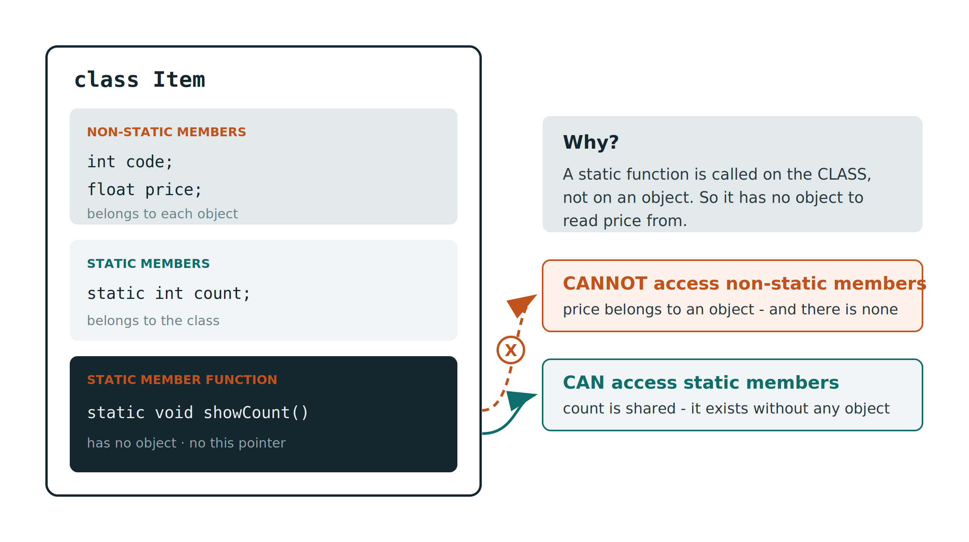
PART C
What a static function may not do
OOP Sessional · Lab 2 · BAUST Khulna
13

Slide 14
PART D · 60 MINUTES
The exercise
Write a class BankAccount that numbers its own accounts from 1001.
Private: accNo, holderName, balance.
Private static: totalAccounts, and interestRate shared by every account.
Public: openAccount(), deposit(), withdraw(), addInterest(), display().
Static: showTotal() and setRate(). Both callable with no object.
Define deposit() and withdraw() OUTSIDE the class using ::
Confirm that a.balance = 99999; refuses to compile.
OOP Sessional · Lab 2 · BAUST Khulna
14

Slide 15
BEFORE YOU LEAVE
Lab report
All three programs with their output, plus the FOUR error messages from Part B,
each with one sentence explaining what caused it.
HOMEWORK · DUE NEXT LAB
Extend BankAccount so it also tracks the TOTAL money held
by the bank across all accounts.
Every deposit and withdrawal must update it. Add a static function showBankTotal().
Next lab: constructors, destructors, and a copy that crashes your program.

